Slide 1
Cell Specialization
How do cells know which proteins to make or what kind of cell to be?

Slide 2
Same instructions – different jobs
Every cell in your body has the same DNA
Before cells become specialized, they are known as Stem Cells
Early in development, pieces of DNA are switched on or off
The on/off switch determines what kind of cell you’ll make
This is specialization or differentiation

Slide 3
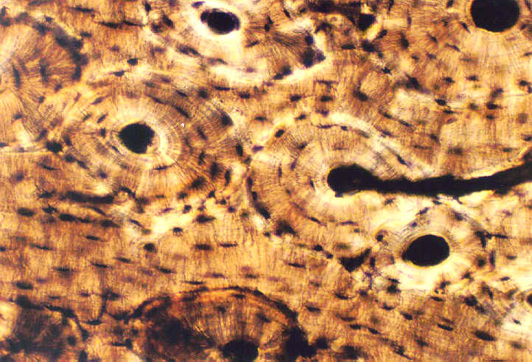
Remember….Structure = Function!
They must support our muscles as they move!
Bone Cells are rigid and packed tightly together.

Slide 4
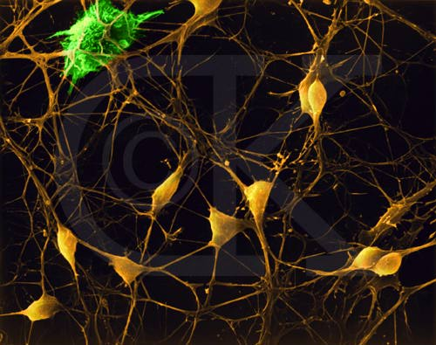
Nerve cells are long and have many branches.
The long branches enable the cells to communicate messages very quickly.

Slide 5
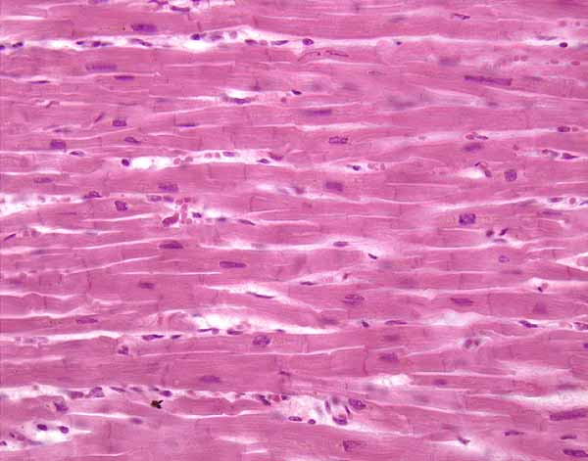
They must be able to shorten (flex) by using lots of ATP!
Muscle cells are long, thick and packed with mitochondria.

Slide 6
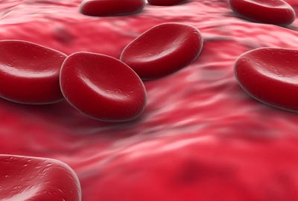
They must be able to easily move through our smallest blood vessels.
Blood Cells are small and rounded.

Slide 7
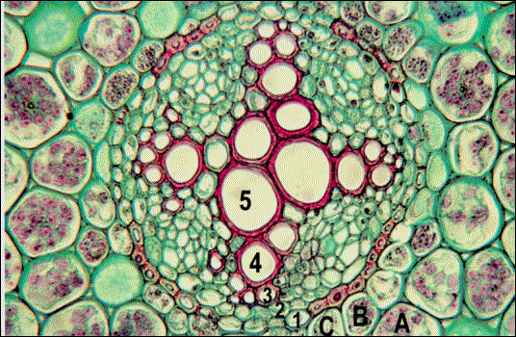
In plants, xylem tissue carries water and phloem carries sugar (food). They are made of vascular cells.
They must be thin and able to stretch. 4 and 5 are vessels lined with xylem and phloem cells.

Slide 8
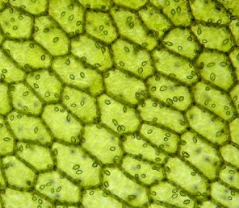
Leaf cells are packed with chloroplasts.
Their chloroplasts allow them to do photosynthesis and make as much sugar as possible.

Slide 9
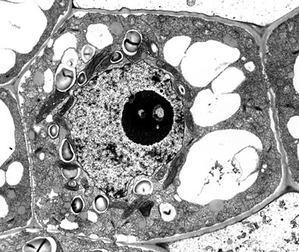
Water enters the plant through the roots. The root cells need a place to keep it!
Root cells are all about vacuoles!

